Slide 1
LC100 NPI
2-Channel HD Recorder and Streaming Media Processor

Slide 2
Overview
Recording
Stream
Store
Produce
Switch
All-in-One Video Solution
Recording
Stream
Store
Micro-Production
Switch

Slide 3
Product Family
LC100
LC200
Multi-channel Video Mixing | 2 Video Source | 4 Video Source
Recording Modes | 1 mixed + 2 individual original | 1 mixed + 4 individual original
Video In | HDMI*2 (one HDMI 2.0) 3G-SDI*1 IP Video Source*2 USB Camera*1 | HDMI*4 IP Video Source*3
Audio In | XLR*2 3.5mm Line In*1 HDMI Audio*2 SDI Audio*2 USB Audio*1 IP Audio*2 | 3.5mm & Line In*4 (Unblance, Stereo) HDMI Audio*4 IP Audio
Video Out | HDMI out*2 HDMI Pass Through*1 (up to 4K) | HDMI*2
LCM | Yes, OSD Menu | NA
Built-in HD | Built-in SATA 2TB HDD | Standard: SATA 1TB HDD Optional: SATA 2TB HDD
Streaming | RTSP / RTP / RTMP / RTMPS / SRT | RTSP / RTP / RTMP / RTMPS
*Only available in special regions

Slide 4
Product I/O
LC100 Front View
Built-in 2TB HDD
Record and Stream
Power/Standby/Reboot
USB 3.0/USB 2.0
Status Screen
Control Knob
Source/Layout Switch

Slide 5
Product I/O
LC100 Back View
USB 3.0
Ethernet
HDMI/SDI IN 1
HDMI/SDI IN 2
XLR Balanced Audio
HDMI Pass-Through (Direct Output from
HDMI IN 1)
Program Out
Multi-view Onboard Director Out
Line In & Line Out

Slide 6
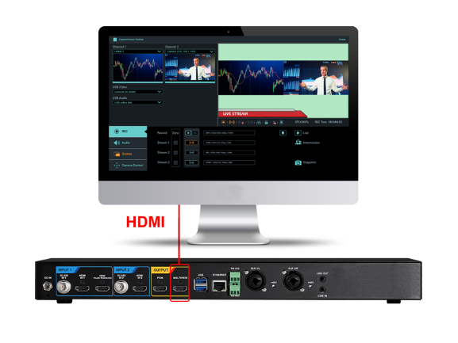
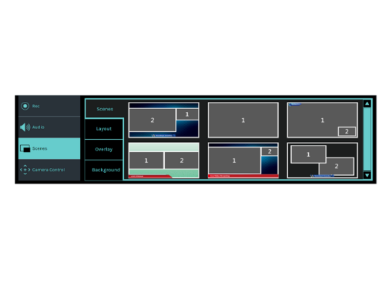
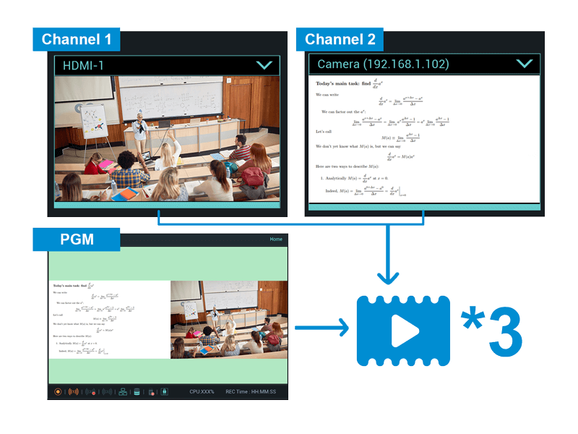
Key Features-1
Onboard GUI Director
Live Pre-defined Scenes for Switching
Program &
ISO Recording
Live control is incorporated into the device. Connect an HDMI screen to the LC100 to access the intuitive GUI. Sessions can be produced live or scheduled in advance.
Build layout scenes that incorporate a variety of visual elements include split screen video, picture-in-picture, title/logo overlays, and background images. Activate and change layouts with the click of a mouse.
The LC100 records the mixed program-out video and captures two video inputs with independent audio. This simplifies media archiving and post-production.

Slide 7
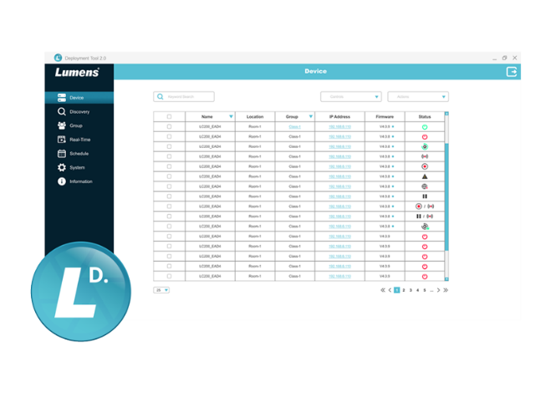
Key Features-2
Deployment Tool for Remote Central Management
Intermission Scene
The Lumens deployment software enables control, management, and administration of multiple LC100 units on the network. Administrators can remotely monitor device status, saving time and reducing costs.
Need a break time during the streaming session? Hit the coffee mark to display the break time page. Users can upload their own designed intermission screen

Slide 8
Competitive Products
Lumens LC100
Epiphan Pearl Nano
Extron SMP351
B&H Price (USD$) | $3,250 | $1,695 | $4790
Recording Resolution and FPS | 1080p 60fps | 1080p 60fps | 1080p 30fps
Recording mode | 1080p60: 3 files | 1080p60: 1 files | 1080p60: 1 files
PTZ Camera Control | Yes | NA | NA
Video In | HDMI*2 (HDMI 2.0 *1) 3G-SDI *2 IP Video Source *2 USB 3.0 *1 | 12G-SDI *1 HDMI *1 IP Stream *1 | HDMI *3 3G-SDI *1 (Optional)
HDMI pass-through | Yes | Yes | NA
Audio In | XLR *2 3.5mm Stereo*1 USB Audio *1 IP Audio from RTSP *2 | XLR *2 RCA (L/R) *1 USB *1 IP Audio from RTSP or SRT *2 | Audio In *2
Storage | Built-in SATA 2TB HDD External: USB 3.0 Storage | SD Card (Up to 512 GB) M.2 (SATA) SSD | Internal 80G SSD
Extension Remote Control Panel | Yes, LC-RC01, up to 30 meter USB extension | USB status light (optional) | Yes, Optional
Warranty | 5-year | 1-year | 3-year

Slide 9
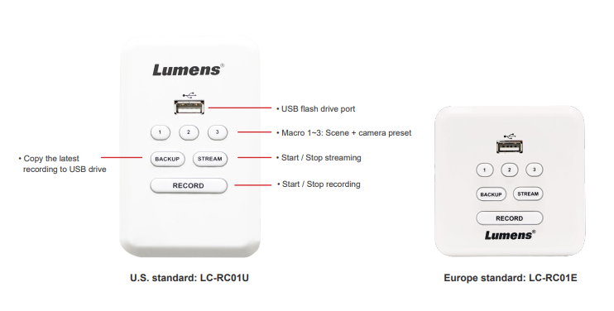
LC-RC01 Remote Control Panel
Accessory
Lumens LC-RC01 remote control panel, a wall plate for the LC100 to control the live streaming, recording, and video file saving options. The panel provides three macro functions that can remotely switch the scene and control the cameras preset. The LC-RC01 can be extended to 30 meters through a Cat 5e cable. Equipped with a USB port, it supports USB flash drives to record or backup video files.
*We provide two Standard remote control panels.

Slide 10
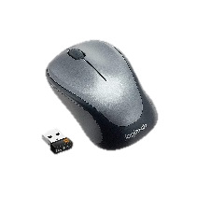
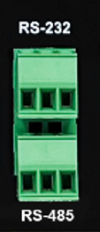
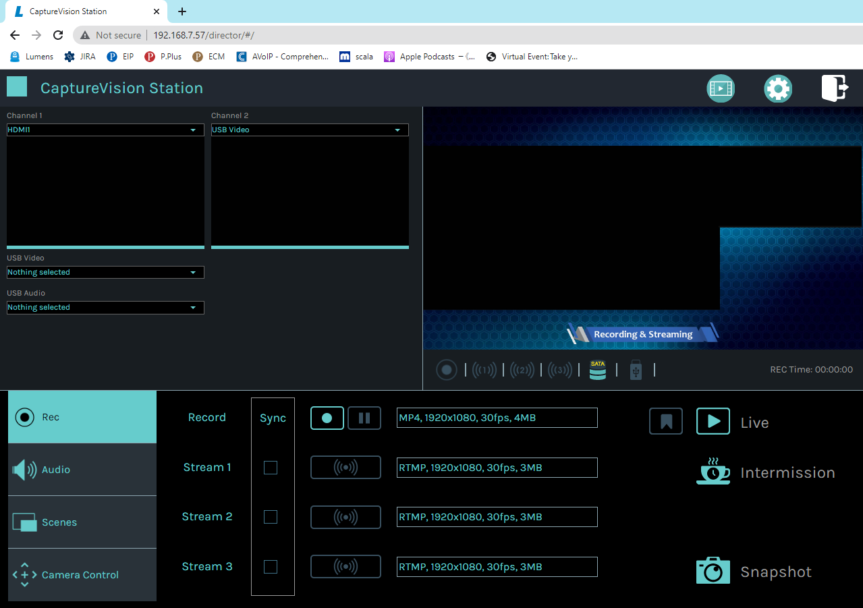
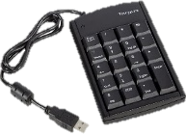
How to Control?
1
2
LC100 provide below control interface.
Remote control panel: LC-RC01
Onboard GUI Interface: Use mouse and keyboard to operate the GUI from Multiview HDMI out.
Online Director: Webpage
USB or wireless keypad: one click to record
RS-232, RS-485, TCP/IP control: Provide command for supporting third-party controller, like Crestron, Extron controllers.
Remote Control Panel
LC-RC01
Onboard GUI
with Wireless mouse
3
4
5
Web Online Director
USB Keypad
RS-232
RS-485

Slide 11
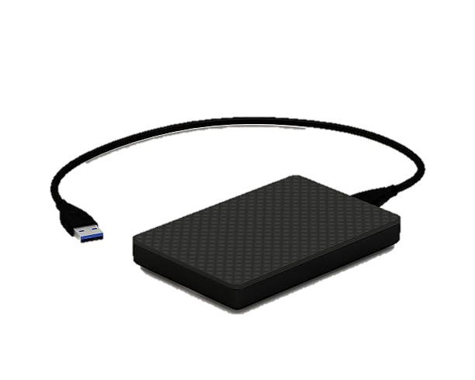
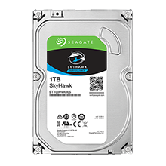
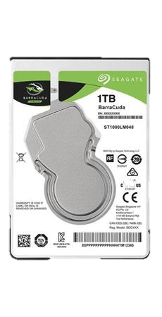
3 Local Storage Options
How to Backup Data (1)?
You can install your data in the build in 2TB storage, or if the build in 2TB is too small you can exchange to bigger HaerdDisk, or you can add one external USB storage.
3.5”
2.5”
Built-in 2TB
Exchange SATA Hard Disk Drive (up to XX TB)
External USB Storage (up to XX TB)

Slide 12
Network Storage
How to Backup Data (2)?
The built-in storage space is limited, and the video files must be uploaded to the network storage space automatically, for the user to backup and manage.
FTP
NAS
You can buckup to LMS (learning
management systems) like Panopto, Kaltura, and Opencast.
You can upload to NAS or FTP/SFTP server

Slide 13
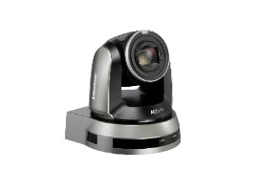
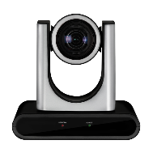
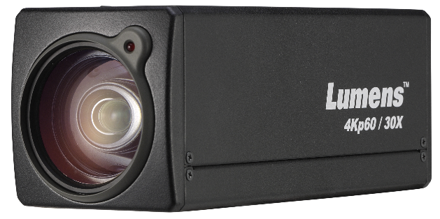
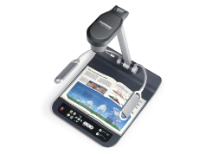
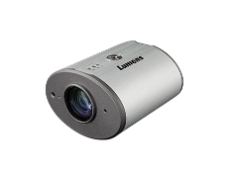
Lumens Products
Integration
LC100 is a powerful all-in-one Media Processor with HDMI, SDI USB, and Ethernet inputs. The various AV inputs make it easier to connect with all ranges of Lumens cameras. LC100 is compatible with Lumens LC-RC01 Remote Control Panel and Lumens Deployment Tool software. It allows you to remotely manage and control LC100 devices.
Camera
Remote Control Panel
Deployment Tool
Media Processor
Accessory
Software

Slide 14
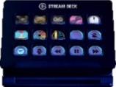
Third Party Partners
Integration
LC100 successfully integrates with major content management systems, popular streaming platforms, broadcasting software, and stream deck. It provides users with more flexible options to use LC100 with their desired platforms.
Stream Deck
Video Content Management
Streaming Platform
Broadcasting Software

